Slide 1
Introducción a Kubernetes con GeneXus
Sebastián Gómez
@sebagomez

Slide 2
Introducción a Kubernetes con GeneXus
Sebastián Gómez
@sebagomez

Slide 3
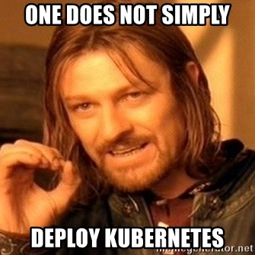
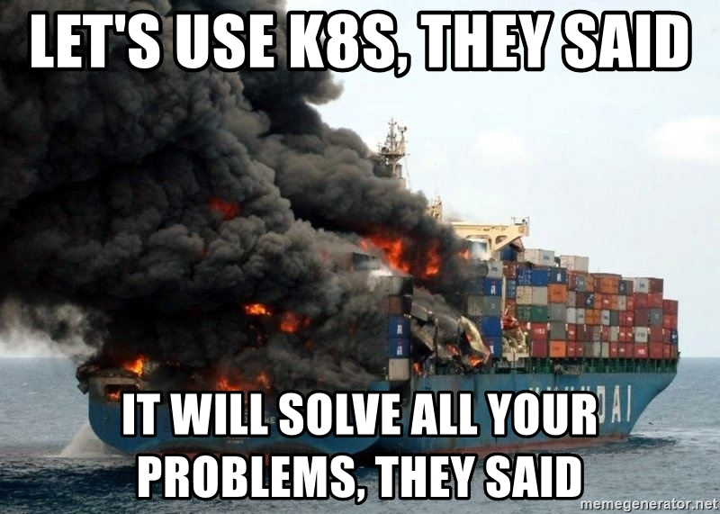
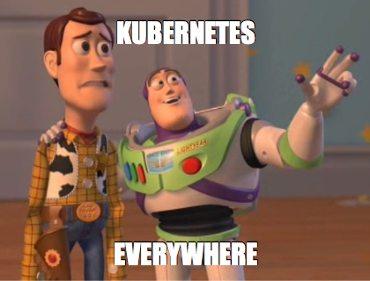
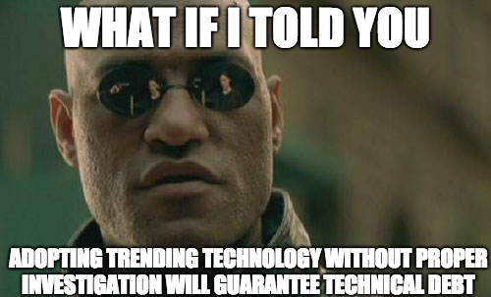
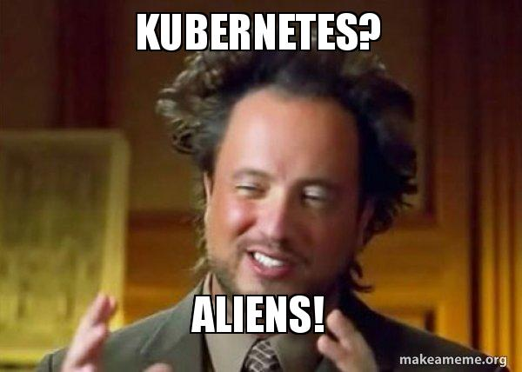

Slide 4

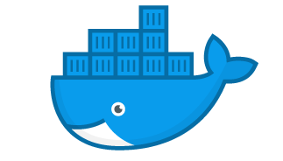
Docker
Abstracting your infrastructure
Isolation
Immutability
Declarative configuration

Slide 5
Demo 1
GX29 running on Docker (Compose)

Slide 6
Docker
Abstracting your infrastructure
Isolation
Immutability
Declarative configuration

Slide 7
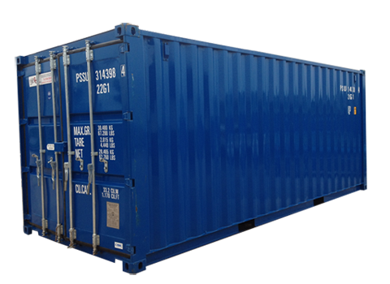
Docker

Slide 8
Docker

Slide 9
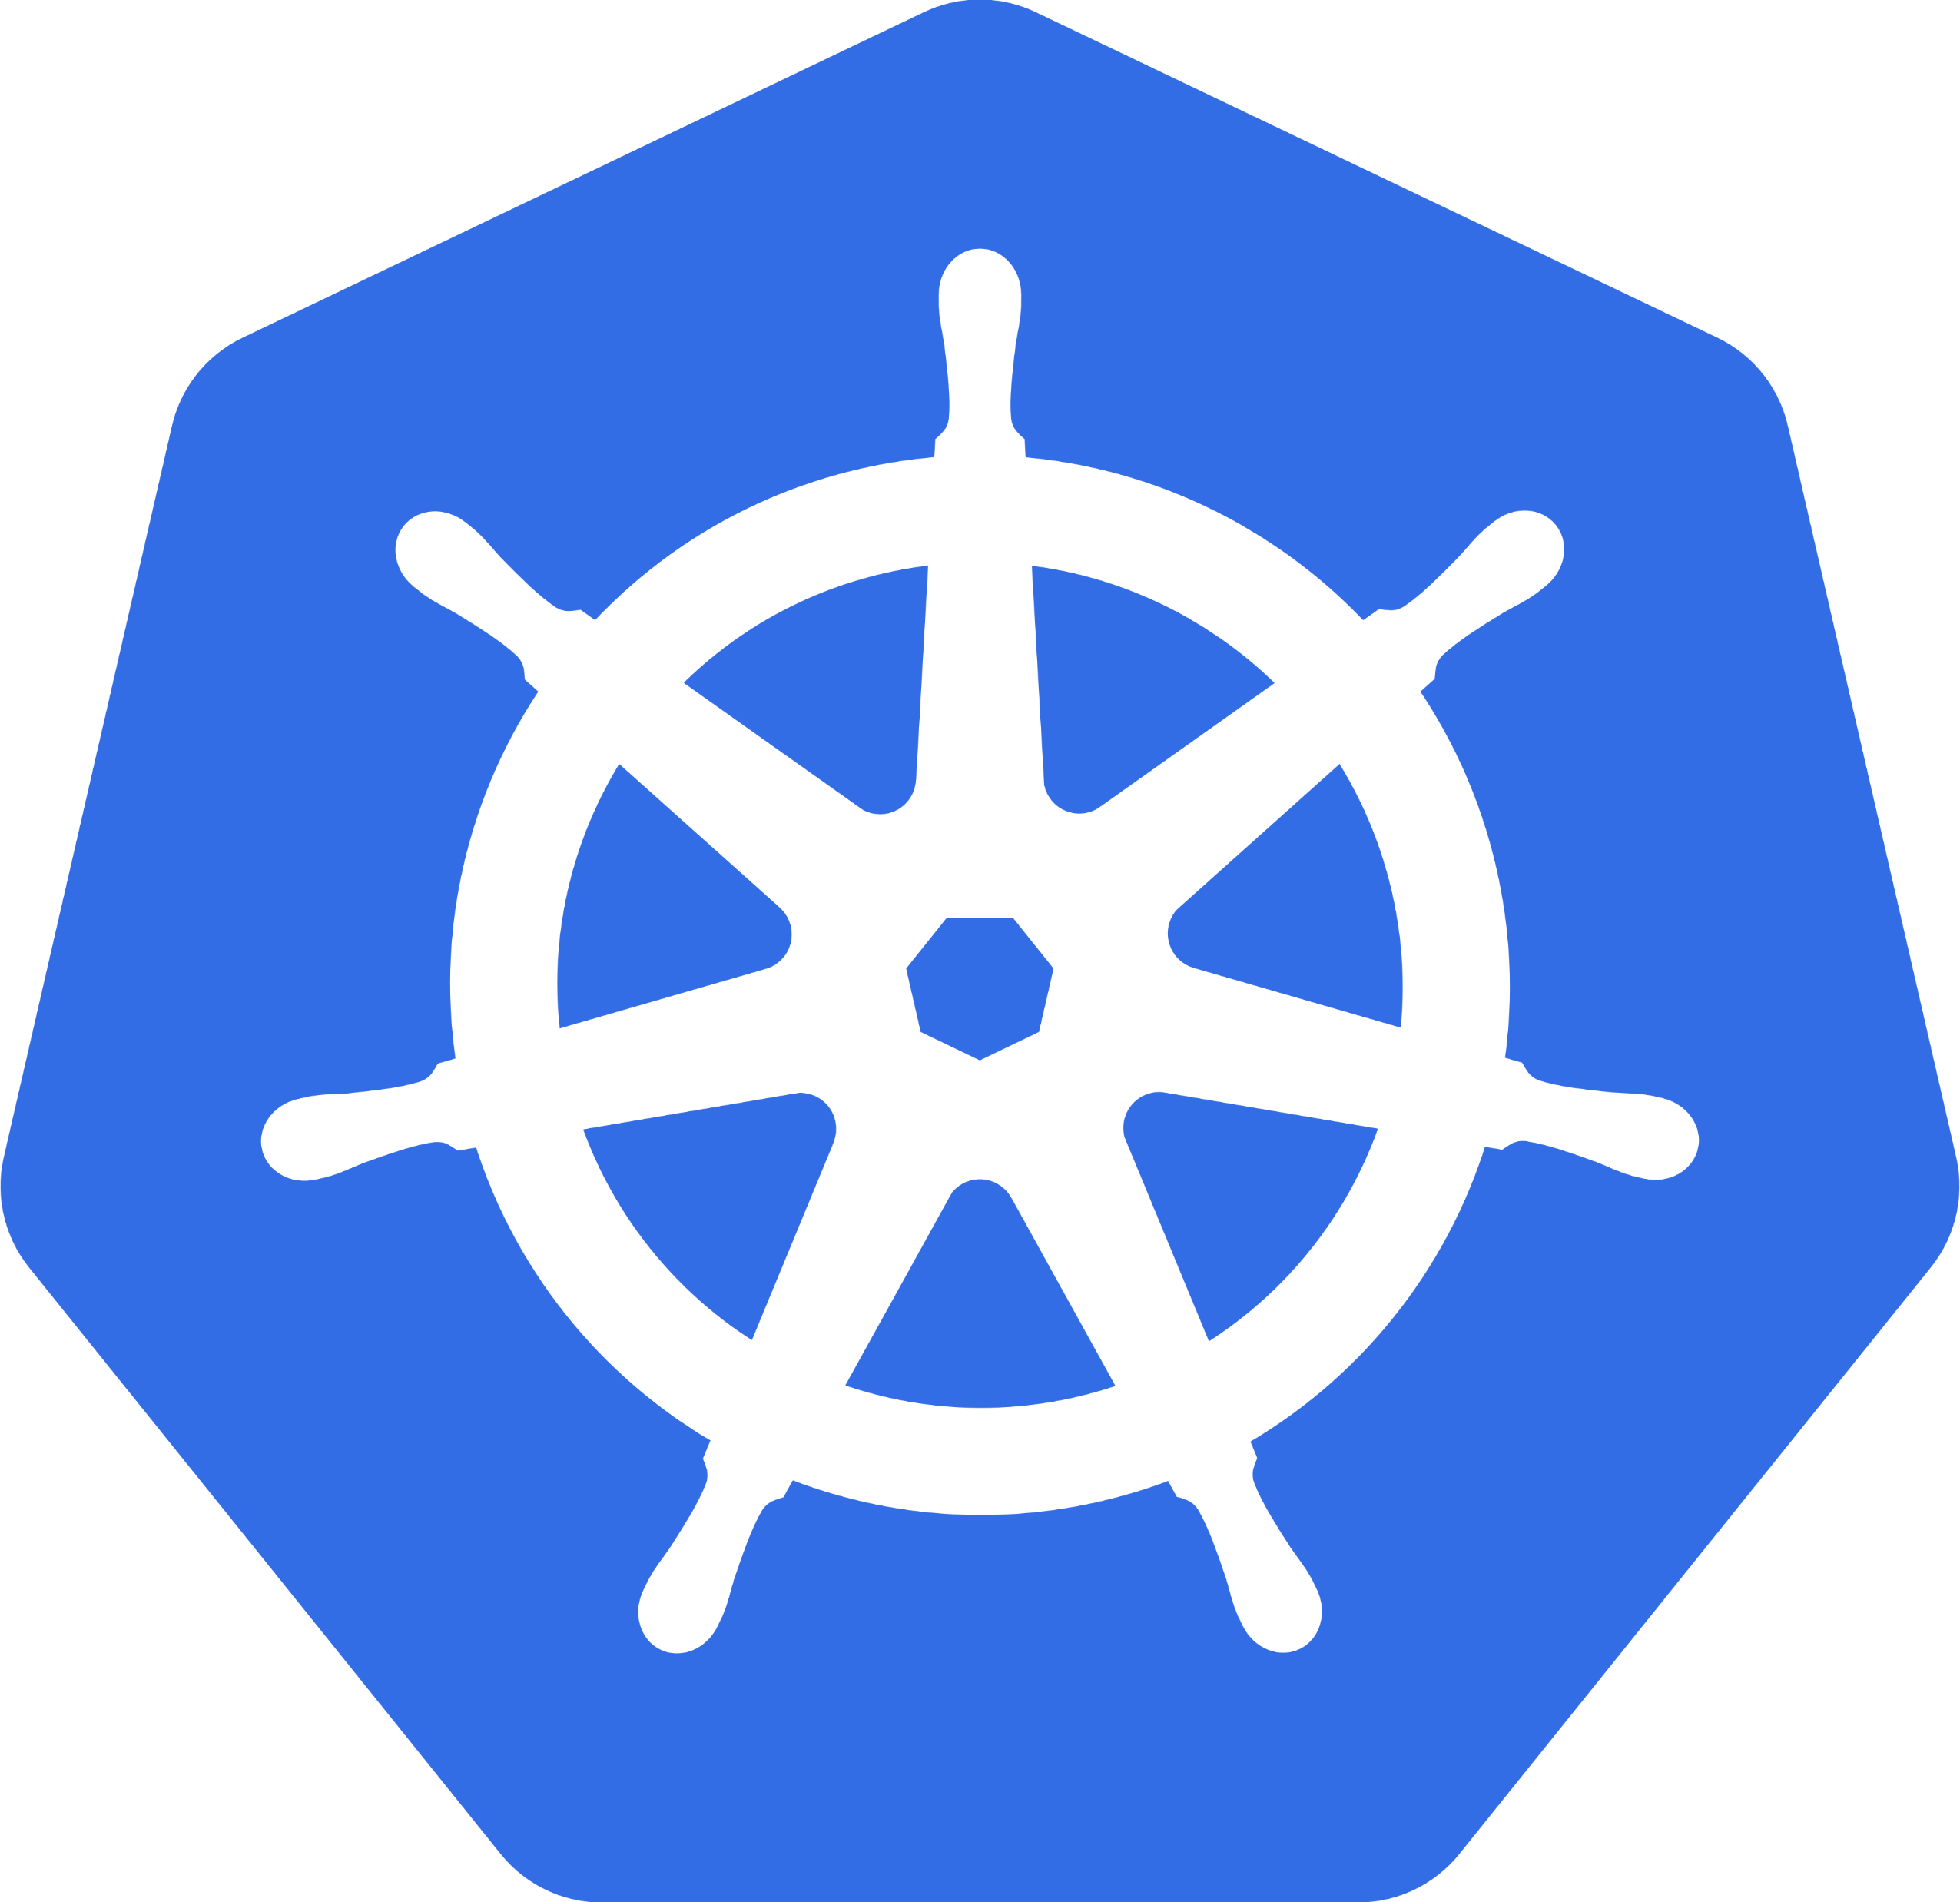
Kubernetes
Open source container orchestrator
Originally developed by Google (Borg)
Deployment
Scaling
Monitoring

Slide 10
Kubernetes
Node
Request:
2 replicas
genexus/gx29_web
Port 8080
Master
Node
Node

Slide 11
Kubernetes
Pods
Deployments
Services
Namespaces
Ingress

Slide 12
Kubernetes
Pods
apiVersion: v1
kind: Pod
metadata:
name: gx29_web
spec:
containers:
- image: genexus/gx29_web
name: gx29_web
ports:
- containerPort: 8080
name: http
protocol: TCP

Slide 13
Kubernetes
Deployments
apiVersion: apps/v1
kind: Deployment
metadata:
name: appgx29-web-app-v1
labels:
app: appgx29-web-app
spec:
replicas: 2
selector:
matchLabels:
app: appgx29-web-app
strategy:
type: Recreate
template:
metadata:
labels:
app: appgx29-web-app
spec:
containers:
- image: genexus/gx29_web:1.1
name: appgx29-web
env:
- name: GX_COM_GX29_DEFAULT_DB_URL
value: jdbc:mysql://gx29-db:3306/GX29?useSSL=false
ports:
- containerPort: 8080
name: external-port
imagePullPolicy: Always

Slide 14
Kubernetes
Services
apiVersion: v1
kind: Service
metadata:
name: appgx29-web-svc
labels:
app: appgx29-web-svc
spec:
ports:
- port: 8080
name: http
selector:
app: appgx29-web-app
type: LoadBalancer

Slide 15
Kubernetes
Namespaces
kind: Namespace
apiVersion: v1
metadata:
name: gx29
labels:
genby: genexus

Slide 16
Kubernetes
Ingress
apiVersion: networking.k8s.io/v1beta1
kind: Ingress
metadata:
name: genexus-ingress
labels:
genby: genexus
spec:
rules:
http:
paths:
- path: /rest
backend:
serviceName: apps-mobile-app-service
servicePort: 8080
- path: /
backend:
serviceName: appgx29-web-app-service
servicePort: 8080

Slide 17
Demo 2
GX29 running on Kubernetes

Slide 18

Storage providers
External session management
Application configuration via environment variables
Console logger
Deploy to Docker (creates Docker Image)
Generate K8s metadata

Slide 19
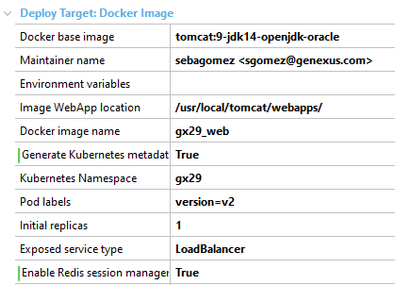

Slide 20
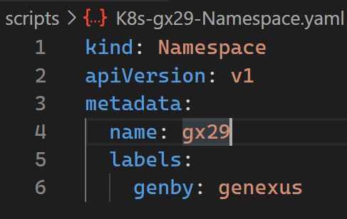

Slide 21
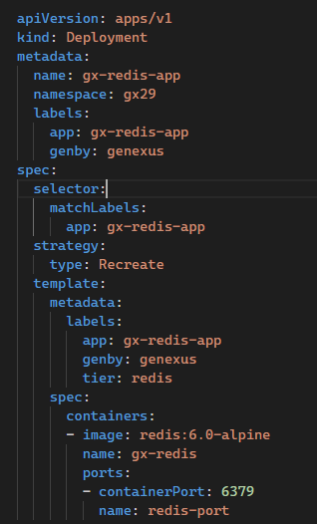

Slide 22
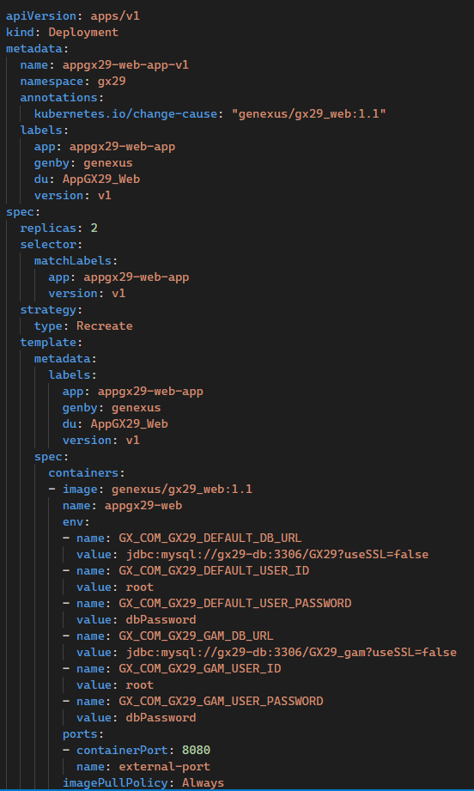

Slide 23
Storage providers
External session management
Application configuration via environment variables
Console logger
Deploy to Docker (creates Docker Image)
Generate K8s metadata

Slide 24

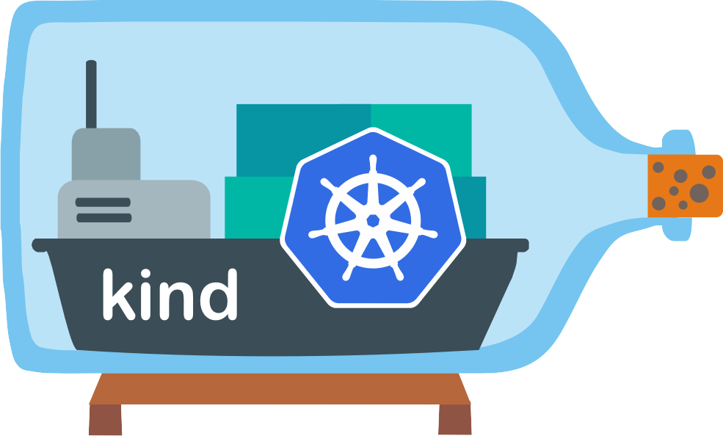
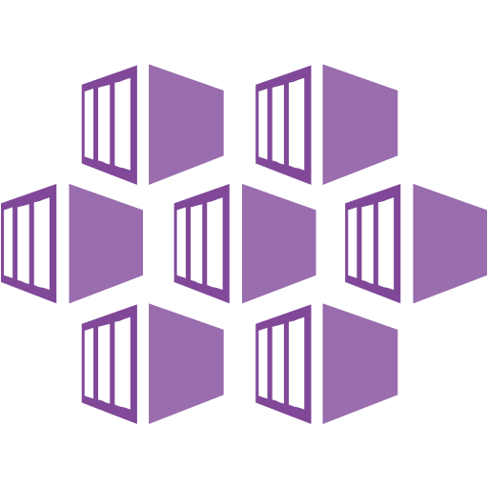

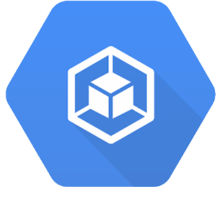

Kubernetes
How to get it?
Docker Desktop
Kind
MiniKube
AKS
EKS
GKE
IKS

Slide 25
Kubernetes
Advanced
DaemonSets
Jobs/CronJobs
Horizontal Pod Autoscaler
Service Mesh
Traffic Management
Observability
Retry
Circuit Breaker

Slide 26


Resources
https://bit.ly/gug-k8s

Slide 27
QnA
Muchas gracias!
@sebagomez

